Slide 1

Unit-1 Foundation Concept
Ideal Institute of Technology

Slide 2
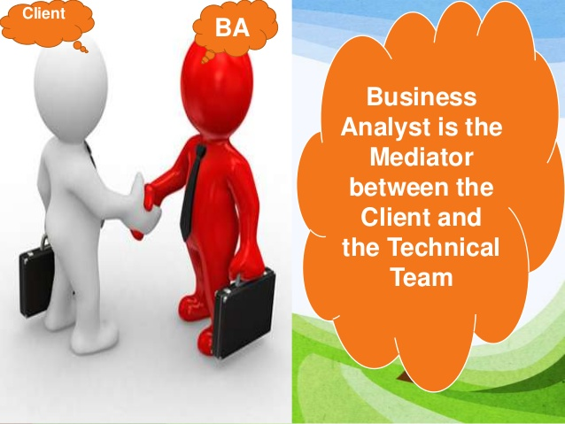
Who is Business Analyst

Slide 3
Business Analyst
Business Analyst are responsible for discovering, synthesizing, and analyzing information from variety of sources within enterprise, including tools, processes, documentation, and stakeholders.
Business Analyst is responsible for eliciting the actual needs of stakeholders –which frequently involves investigating and clarifying their expressed desires-in order to determine underlying issues and causes.

Slide 4
Activities that Business Analysts Perform Include
Underlying enterprise problems and goals
Analyzing needs and solutions
Devising Strategies
Driving change
Facilitating Stakeholder Collaboration

Slide 5
What is Business Analysis
Business Analysis is the practice of enabling Change in the enterprise by defining needs and recommending solutions that deliver value to stakeholders.
Business Analysis enables an enterprise to articulate needs and the rationale for change, and to design and describe the solutions that can deliver value.

Slide 6
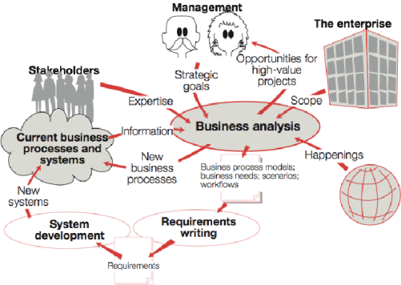

Slide 7
Essential Skills of Effective Business Analysts
Being the expert in Particular area does not guarantee success as a Business Analyst on project. In addition to the necessary business and domain knowledge ,The business Analyst should have management, interpersonal, business and problem-solving skills.

Slide 8
Relationship-Building Skills
First and foremost on the list of soft skills is the ability to forge strong relationships, often called stakeholder relationships. A stakeholder is simply anyone who has something to contribute to your project and often you’ll work with many stakeholders from both the business and the technical teams.
This skill involves building trust and often means stepping into a leadership role on a project team to bridge gaps.

Slide 9
Self-Managing
While BAs are not project managers, the most successful BAs manage the business analysis effort. This means that the BA is proactive and dependency-aware. It also means they manage themselves to commitments and deadlines, a skill set which can involve influence, delegation, and issue management.

Slide 10
A Thick Skin
BAs receive a barrage of feedback – on their documentation and proposed solutions. To succeed as a business analyst you need to be able to separate feedback on your documents and ideas from feedback on you personally.

Slide 11
Visual Modeling
A close sister to many analysis techniques is the ability to create visual models, such as work-flow diagrams or wireframe prototypes. For any given analyst role, there could be specific models you need to create. As a general skill set, it’s important to be able to capture information visually – whether in a formal model or a napkin drawing.

Slide 12
Active listening
It is a communication technique used in counseling, training and conflict resolution, which requires the listener to feed back what they hear to the speaker, by way of re-stating or paraphrasing what they have heard in their own words, to confirm what they have heard and moreover, to confirm the understanding of both parties .
Communication is incomplete if the listener does not comprehend what is being said. Re-stating and paraphrasing is an effective way to understand what the other person is saying. While doing so do not miss out on important facts. Watch for body language too. It provides clues to the importance of the requirement as well as UI design. For example, while discussing a requirement the users may gesture a drop down or a click without verbally stating it. Note them down.

Slide 13
Patience
It’s a virtue that all BA’s must have. First, not everyone has clarity of thought.
Second, business users do their job really well but may not be articulate enough.
Third, they may not have the patience to sit and explain fundamental things to you. It’s like being in a relationship. Two impatient people make the situation quite explosive. This attribute is something to be cultivated.

Slide 14
Communication Skill
As an effective communicator, you must to able to facilitate work meetings, ask the right questions, and actively listen and take in new information. The ability to communicate proficiently in person, on conference calls, in meetings both digital and otherwise, and through email is essential.
Business analysts spend a significant amount of time interacting with clients, users, management, and developers. A project’s success may revolve around your ability to clearly communicate things like project requirements, changes, and testing results.

Slide 15
Negotiation Skills
A business analyst is the intermediary among a variety of people with various types of personalities: clients, developers, users, management, and IT.
You have to be able to achieve a profitable outcome for your company while finding a solution for the client that makes them happy. Balancing both takes persuasion skills to reach a mutual solution while maintaining professional relationships.

Slide 16
Computer Skills
As a business analyst, you’ll need to be able to use many types of software, from the popular Microsoft Office Suite, to less common packages, like SharePoint, Visio, and Software Design Tools. You will need to stay abreast of new developments in relevant IT as well.
Microsoft Excel
Microsoft Office
Microsoft Project
PowerPoint
SQL Queries
Software Design Tools
Visio

Slide 17
Personal Attributes
Sought-after personal attributes include adaptability and the ability to work in a fast-paced environment with cross-functional teams. You’ll need analytical thinking, attention to detail, and creativity. You’ll need to have strong organizational skills, the ability to multitask, and the ability to act as a strong but diplomatic leader.
Ability to Adapt and Quickly Adjust to Change
Ability to Work in Fast Paced Environment
Ability to Work with Cross-Functional Teams
Analytical
Assessment
Attention to Detail
Creative Thinking
Critical Thinking

Slide 18
Defining Problems
Detail Oriented
Decision Making
Diplomatic
Innovation
Instructing
Leadership
Listening
Meeting Deadlines
Multi-Tasking
Organizational Skills
Planning
Prioritizing
Written Communication

Slide 19
Business Analyst Key Terms
Business Analysis Information:
Business Analysis Information refers to the broad diverse set of Information that business analyze, transform and report.
It is information of any-kind –at any level of detail –that is used as an input to or output of business analysis work.
Design:
A design is a usable representation of solution. Design focuses on understanding how value might be realized by a solution if it is built.

Slide 20
Enterprise:
An enterprise is a system of one or more organizations and he solutions they use to pursue a shared set of common goals .These solutions can be processes ,tools or information. For the purpose of Business Analysis ,enterprise boundaries can be defined relative to change and need not be constrained by the boundaries of legal entity.
Organization:
A social unit of people that is structured and managed to meet a need or to pursue collective goals. All organizations have a management structure that determines relationships between the different activities and the members, and subdivides and assigns roles, responsibilities, and authority to carry out different tasks. Organizations are open systems--they affect and are affected by their environment.

Slide 21

Plan:
Written account of intended future course of action (scheme) aimed at achieving specific goal(s) or objective(s) within a specific timeframe. It explains in detail what needs to be done, when, how, and by whom, and often includes best case, expected case, and worst case scenarios.
Requirements :
It is the most crucial part of the project. Incorrect, inaccurate, or excessive definition of requirements must necessarily result in schedule delays, wasted resources, or customer dissatisfaction. The requirements analysis should begin with business or organizational requirements and translate those into project requirements. If meeting stated requirements will be unreasonably costly, or take too long, the project requirements may have to be negotiated down, down-scoped or down-sized, in discussions with customers or sponsors.

Slide 22
Developer:
A software developer is a person concerned with facets of the software development process, including the research, design, programming, and testing of computer software. Other job titles which are often used with similar meanings are programmer, software analyst, and software engineer.
Tester:
A technician who conducts prescribed tests on software programs and applications prior to their implementation to ensure quality, design integrity and proper functionality. They apply rigorous testing methods including extensive end-user simulations to uncover program "bugs" which are then eliminated by the programmer.

Slide 23
SME:
Subject matter Experts
End User
Client
Customer
Sponsor
Supplier
Project manager
Stakeholder

Slide 24
Business Analyst Knowledge Areas
Business Analysis Planning and Monitoring
Elicitation
Enterprise Analysis
Requirements Analysis
Solution Assessment and Validation
Requirements Management and Communication
Underlying Competencies

